Slide 1

TEAM NAME :
TechSlayers
MEMBER DETAILS

Slide 2
PROBLEM STATEMENT:
Visual spoofing is the leading breach vector for banking and higher education. These "pixel-perfect" clones replicate site architecture so precisely they bypass traditional URL-based heuristics.
The critical escalation is Zero-Day Phishing. These attacks utilize newly registered, "clean" domains with no historical footprint, allowing them to slip past reputation-based filters undetected. Because they lack a known signature, they function as a zero-day vulnerability for the human element. By the time security lists update, the breach is finished. Modern defense requires Computer Vision AI to detect visual impersonation instantly, regardless of the URL's age or reputation.

Slide 3
Existing Systems
URL Blacklists:
Limitation: Reactive. Takes hours/days to update; fails against zero-day sites created seconds ago.
SSL Certificate Check:
Limitation: 58% of phishing sites now use valid HTTPS (padlock icon), rendering this check useless for trust verification.
Traditional Antivirus:
Limitation: Relies on file scanning or signature matching, often missing browser-based DOM (Document Object Model) manipulation.

Slide 4
PROPOSED SOLUTION:
Phishing Sentinel Ecosystem: A dual-layer intelligent defense system comprising "The Guardian" (Browser Extension) and "The Intelligence Hub" (Web Portal).
Core Logic: Unlike standard filters that read URLs, our system "looks" at the website like a human. It uses a lightweight Computer Vision & DOM Analysis model to detect if a site is visually pretending to be a target (e.g., a fake HDFC login page) regardless of the URL.
Action: Real-time interception and blocking of malicious sites before the user can enter credentials.

Slide 5
NOVELTY:
Visual-Structural Analysis: We analyze the structure (DOM) and visuals of the page, not just the text URL.
Edge-First Intelligence: Privacy-preserving ML runs locally on the browser ("Edge Hook"), reducing latency to milliseconds.
Hybrid Verification: Combines local speed with a "Cloud Sync" deep scan for high-confidence verdict, minimizing false positives.

Slide 6
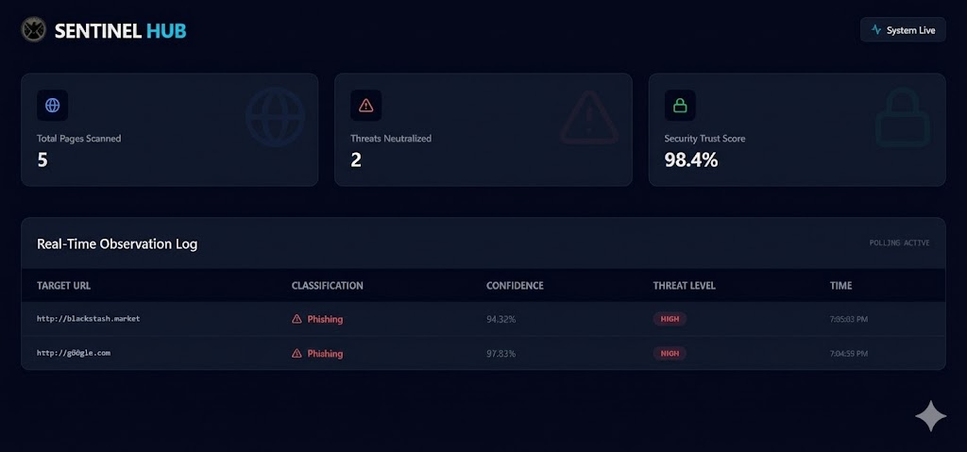
TECH STACK USED AND SOLVING APPROACH:
Tech Stack:
Frontend/Extension: React.js, HTML5, Manifest V3 (Chrome Extension Standard).
Backend API: Golang (for high-concurrency request handling).
ML Engine: PyTorch & FastAPI (Python) for DOM structure inference.
Database: PostgreSQL (Supabase).
Solving Approach (Workflow):
Intercept: Extension detects page load.
Extract: Scrapes DOM structure keypoints.
Infer: Local ML model analyze DOM structure.
Verdict: If visual match = High but URL match = Low -> BLOCK.

Slide 7
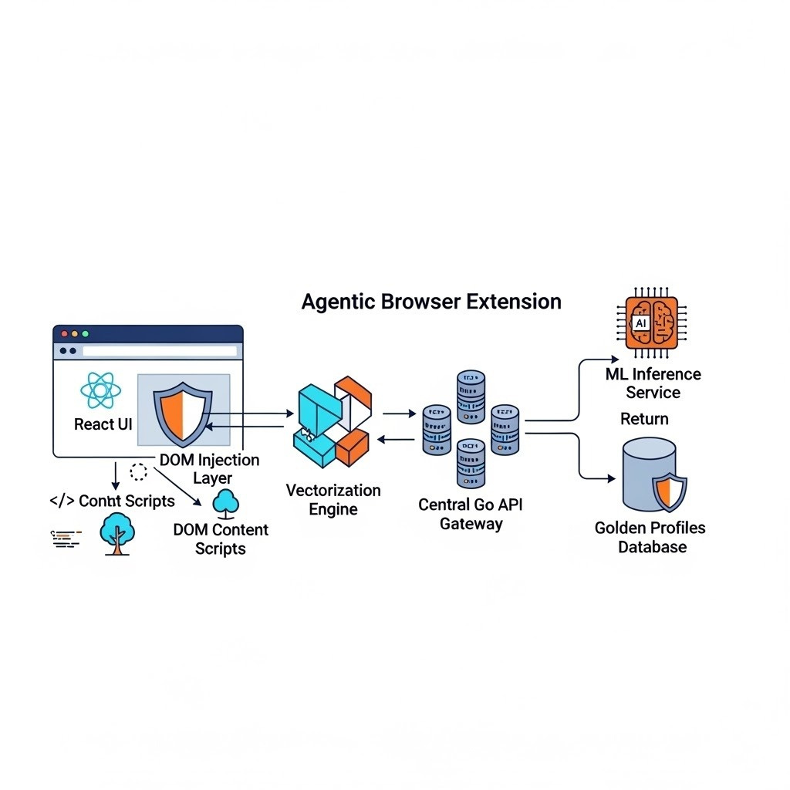
ARCHITECHTURE DIAGRAM :
User Layer: Browser Tab (User visits site).
Edge Layer: "The Guardian" Extension acts as a middleware.
Arrow to: Local Inference Engine (Lightweight JS Model).
Cloud Layer:
Golang API Gateway receives hash of suspicious site.
Arrow to: Python ML Service (Deep Analysis).
Arrow to: MySQL Database (Global Threat List).
Feedback Loop: System updates local extension with new threat
signatures.

Slide 8
FEASIBILITY & SCALABILITY:
Feasibility:
Low Latency: Asynchronous processing ensures the user experiences NO browsing lag.
Browser Compatible: Built on standard Manifest V3, compatible with Chrome, Edge, and Brave immediately.
Scalability:
Go-Routines: The Golang backend is chosen specifically to handle thousands of concurrent requests with minimal CPU usage.
Distributed AI: By offloading initial checks to the client (User's browser), server costs are drastically reduced, allowing scaling to millions of users cheaply.

Slide 9
CONCLUSION :
Summary: Phishing Sentinel bridges the critical gap between user error and technical security.
Impact: Protects financial assets by neutralizing the most common attack vector (Social Engineering/Spoofing).
Vision: To create a decentralized trust layer where users can transact online with mathematically verified confidence.

